Slide 1
DATA GETS PERSONAL
Louisa H. Smith
PhD candidate in epidemiology
Harvard TH Chan School of Public Health
January 29, 2019

Slide 2
Tonight’s goal
Tell a
(data science?
human interest?)
story with R.

Slide 3
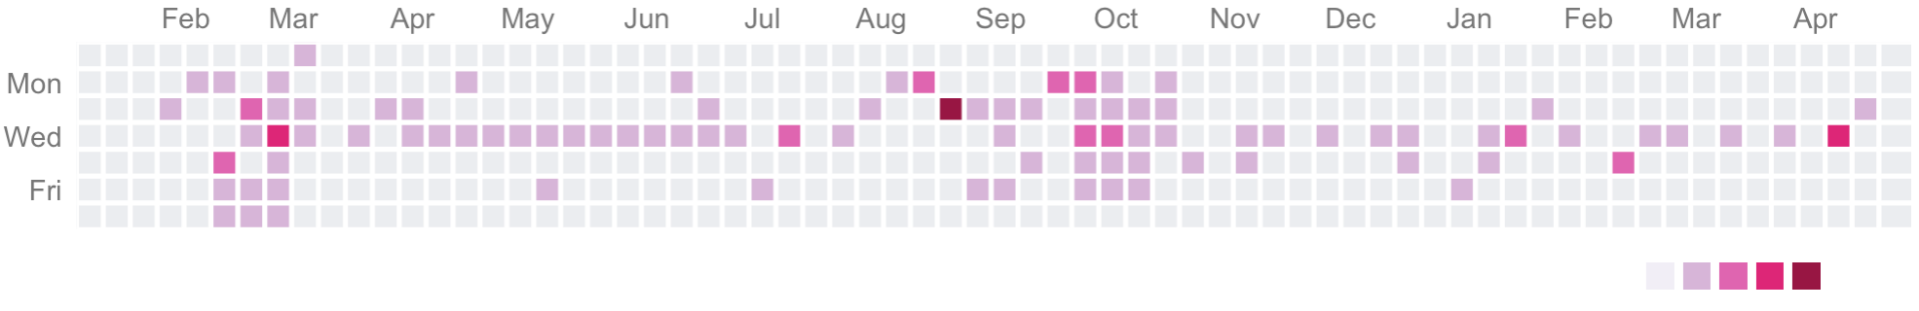
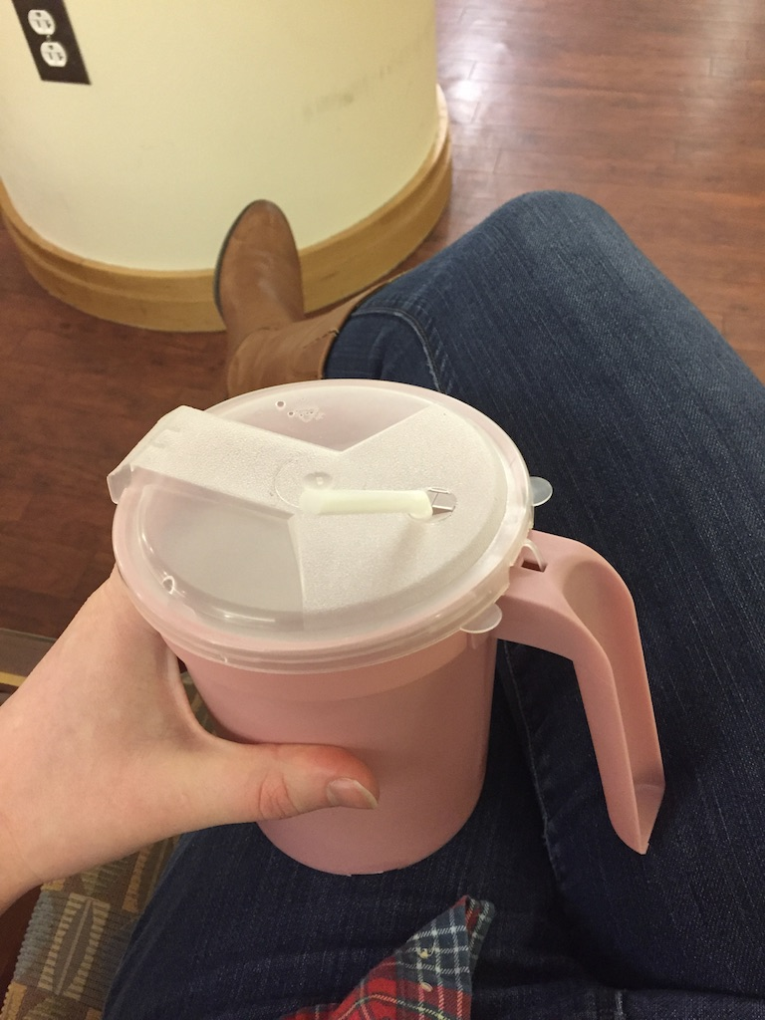
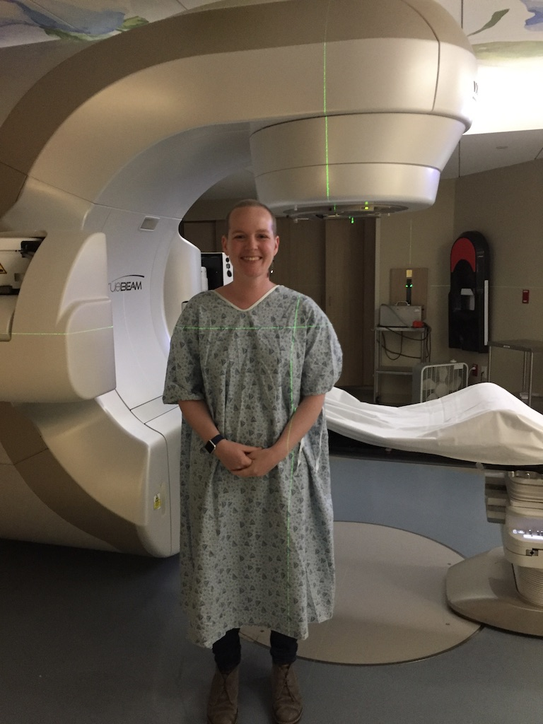
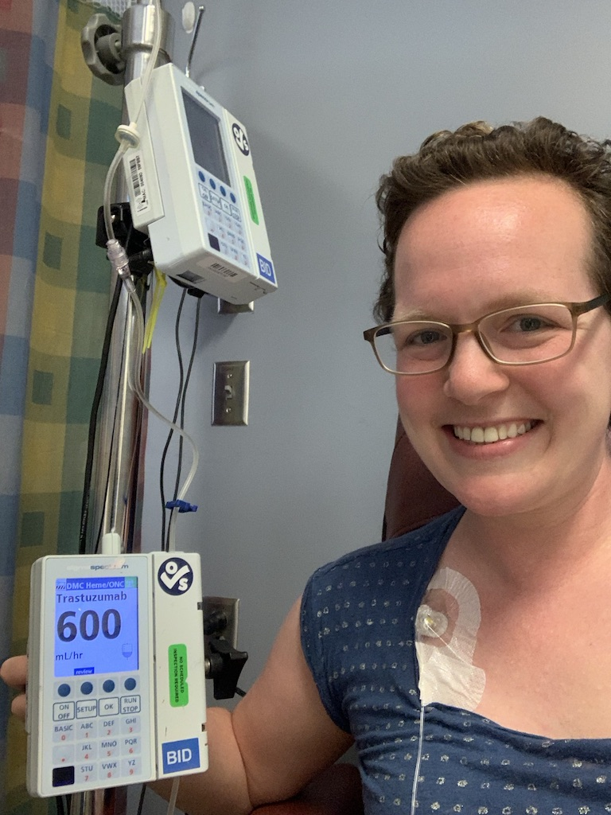
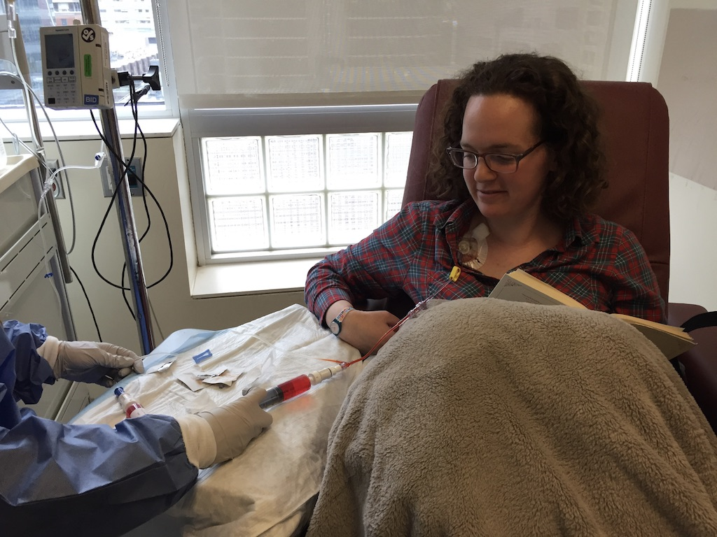
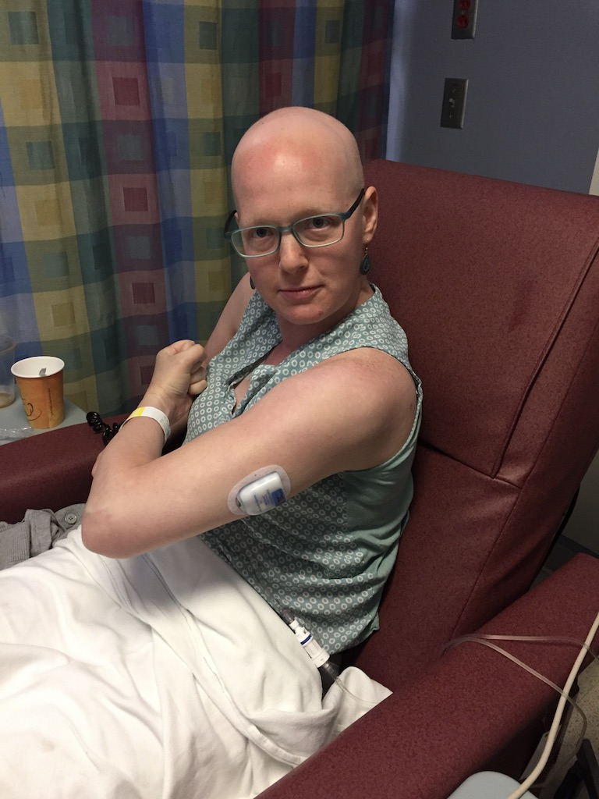
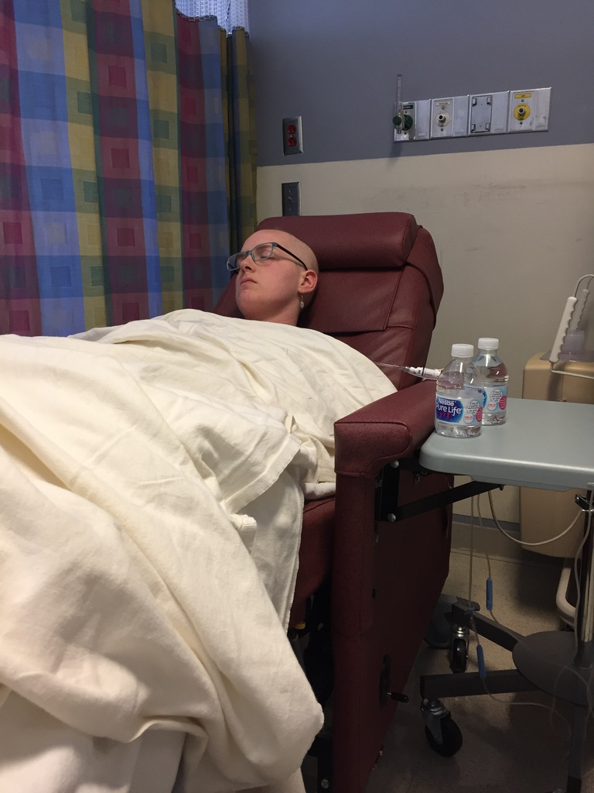
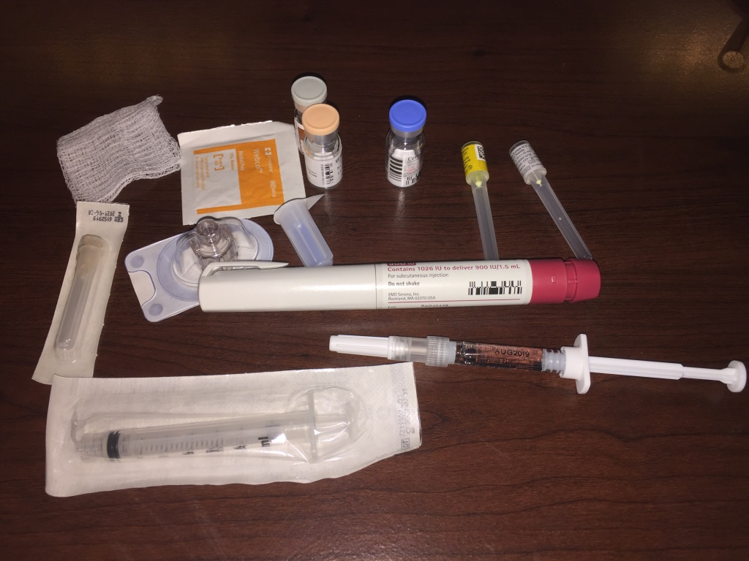
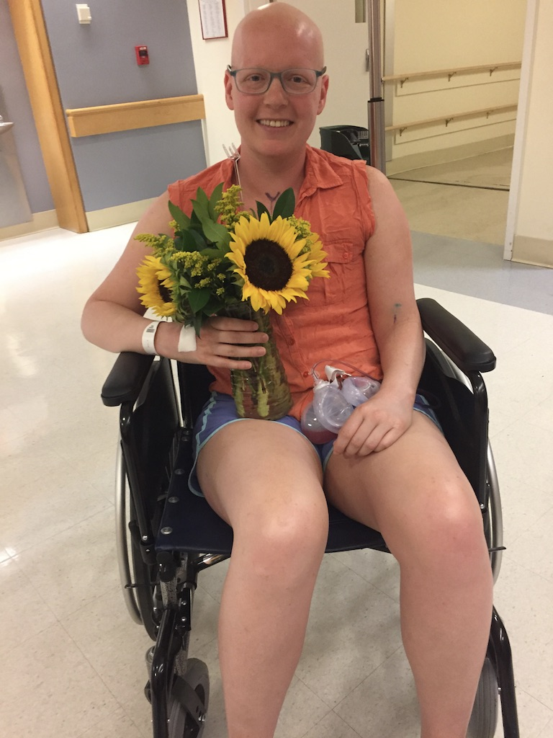
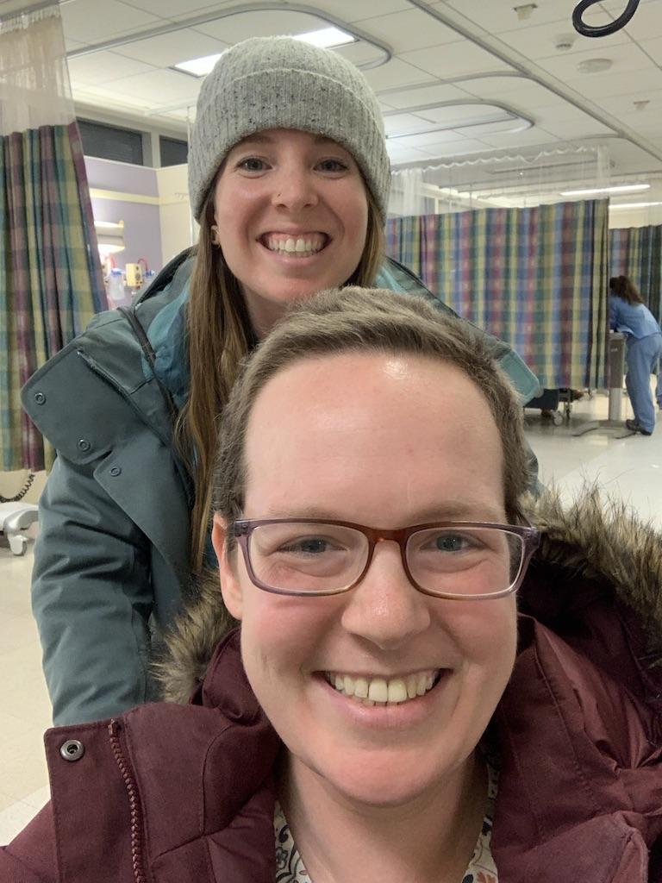
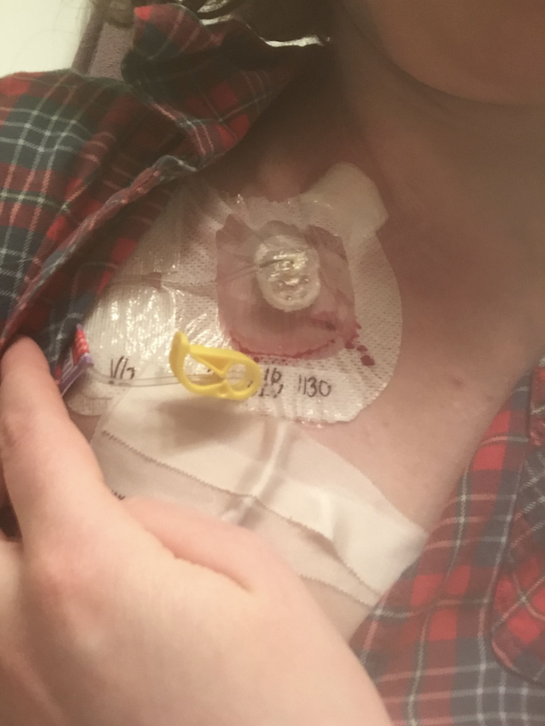
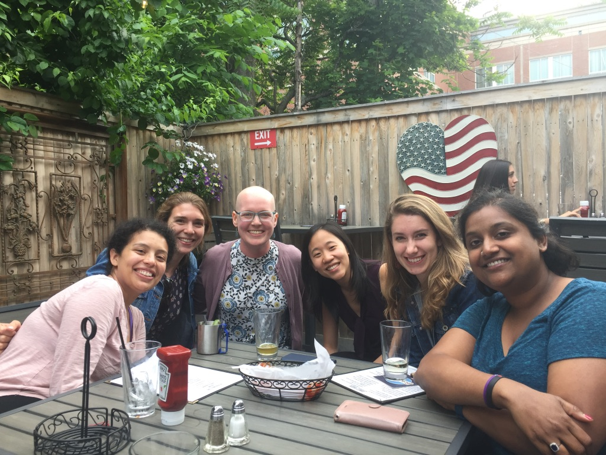
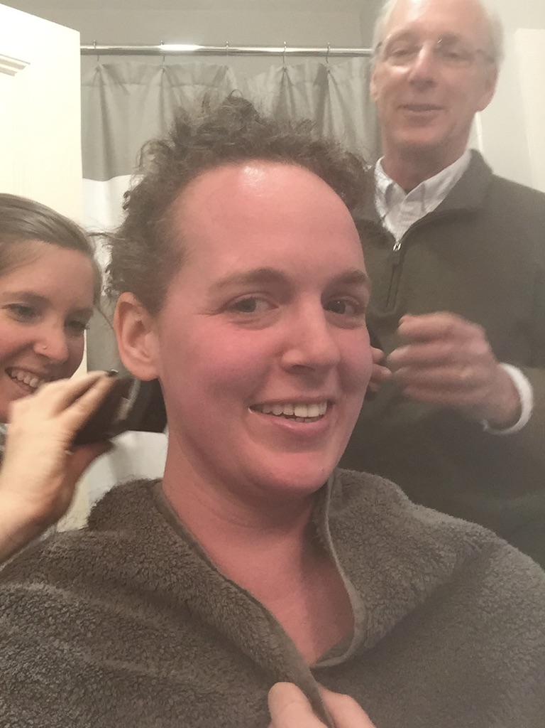
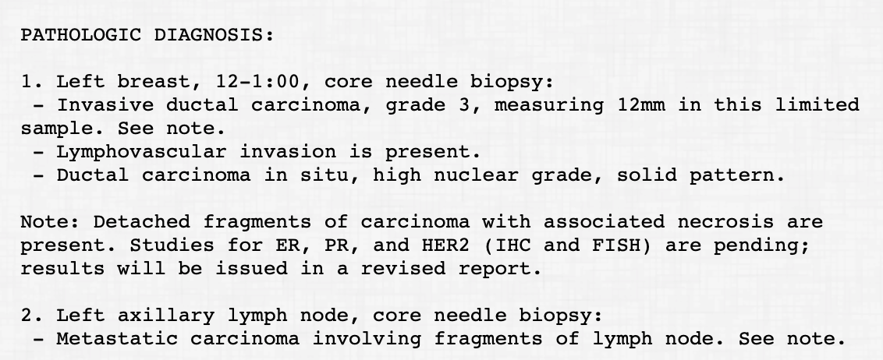

Slide 4
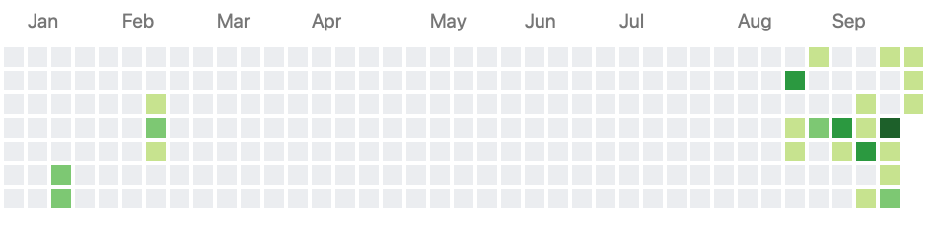
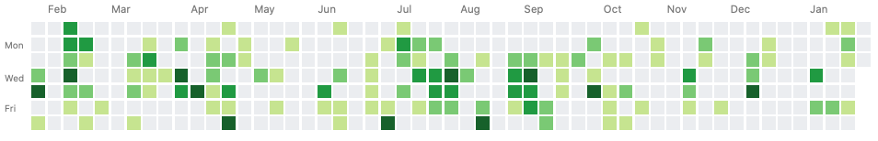
Inspiration
(what it actually looked like during that time)

Slide 5
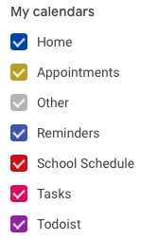
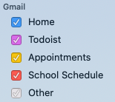
Process
Export calendar as .ics
I keep all my medical appointments as a separate calendar
Exporting is easy with Google Calendars, iCal, I’m sure others
Convert .ics to .csv
I used an online tool: http://www.indigoblue.eu/ics2csv/
Clean data!
I got some help getting it in the format I want for plotting from the source code of this blog post: https://www.garrickadenbuie.com/blog/greatest-twitter-scheme/
Full explanation here:
https://www.louisahsmith.com/post/github-style-calendar-heatmap/

Slide 6
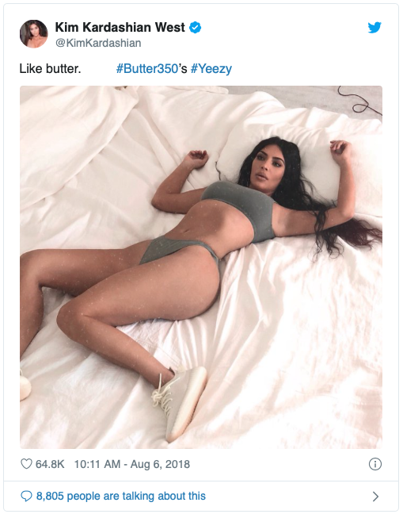
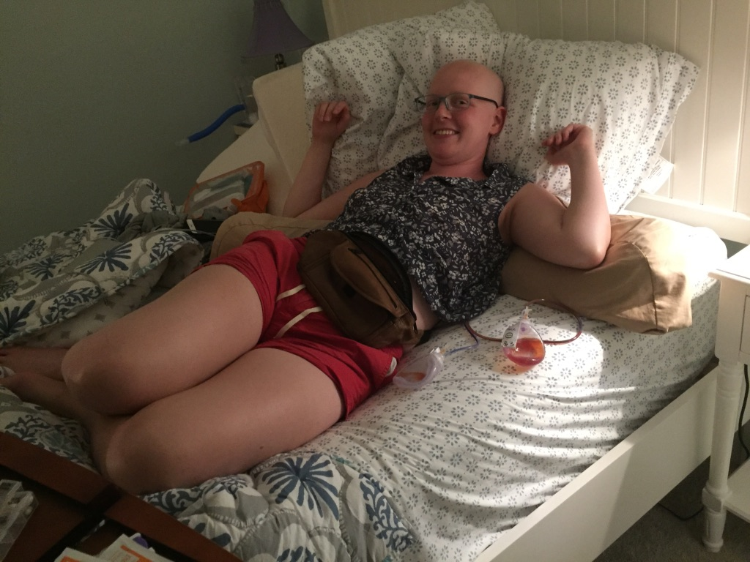

Slide 7
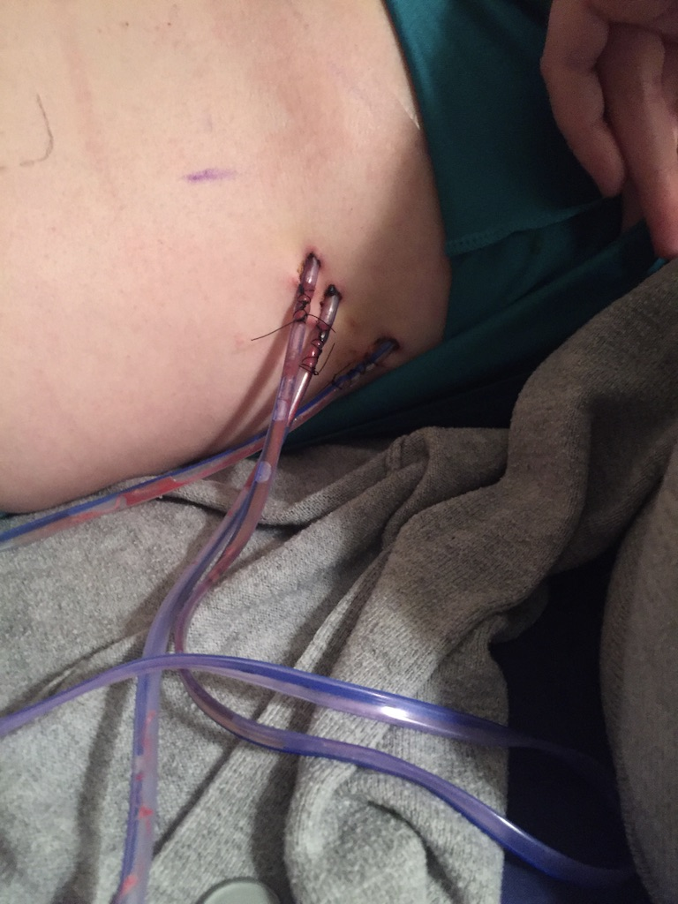
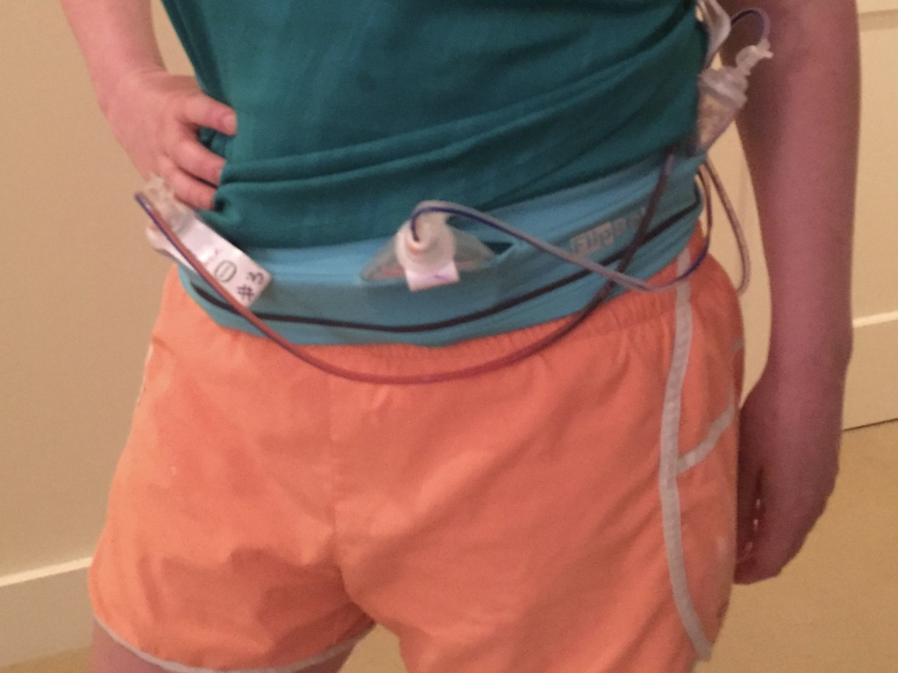

Slide 8
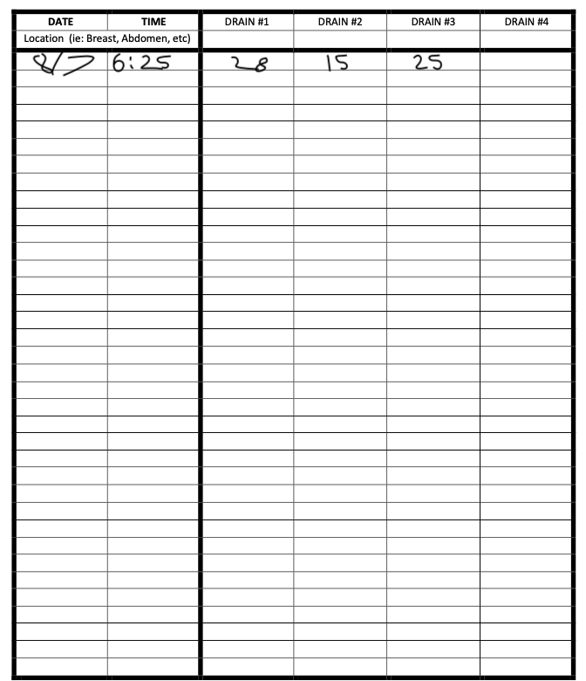
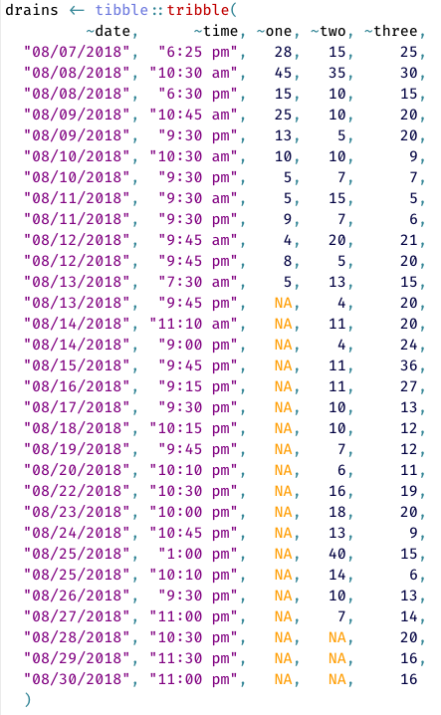
What they expected…
What they got…

Slide 9
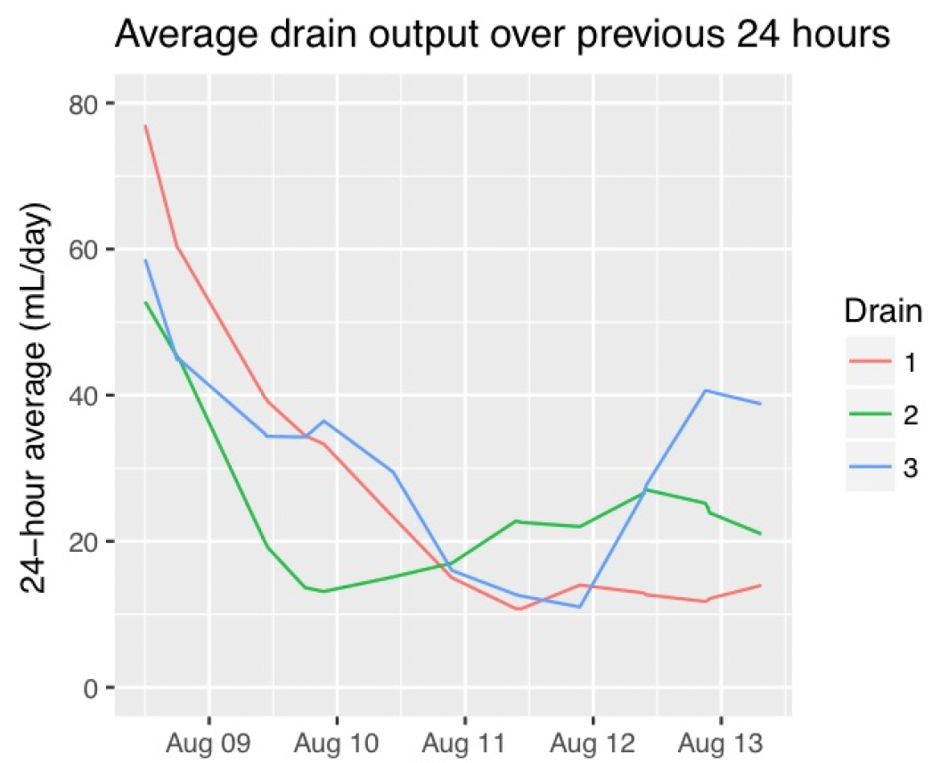
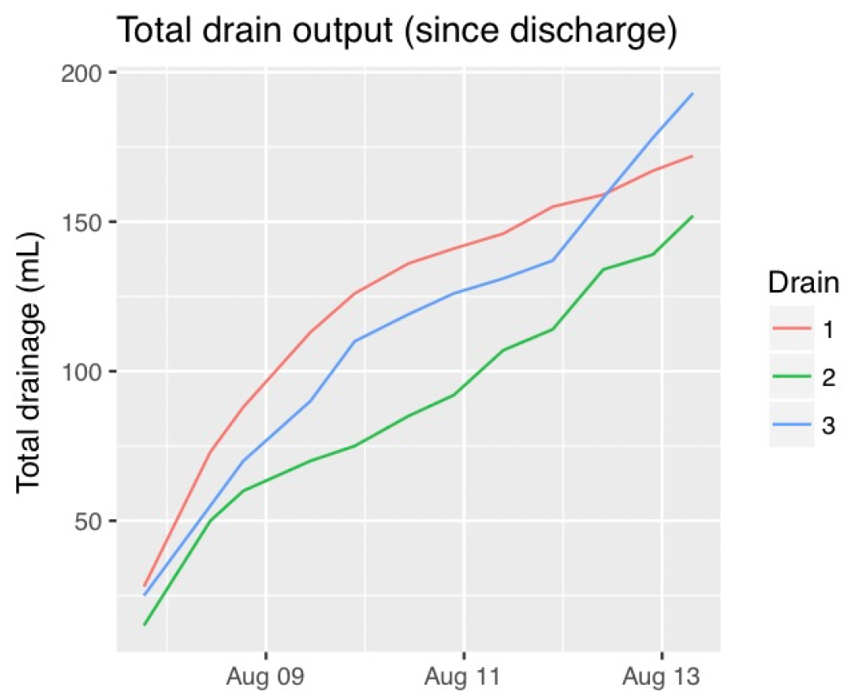
Removal is based on 24-hour output

Slide 10
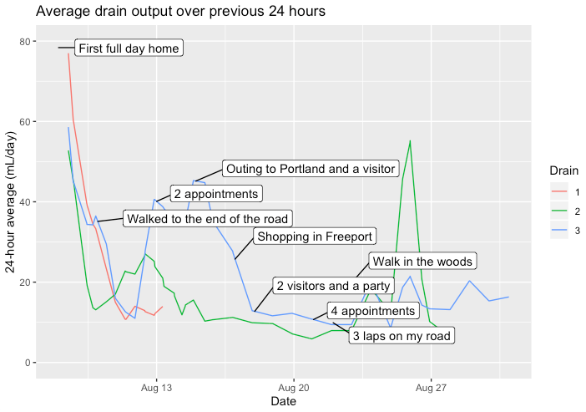
Tried to see what correlated with high output
As you can imagine, drains are really uncomfortable….

Slide 11
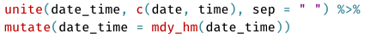
Process
Collect data
tibble::tribble() is my go-to for on-the-spot data collection:
Kept notes on my phone and would move it to R whenever I had the chance
Use datapasta to keep nice and neat! (more later)
Clean data
Between tidyr and lubridate, easy creation of dates:
RcppRoll for calculating rolling averages
ggrepel for adding labels to ggplots

Slide 12
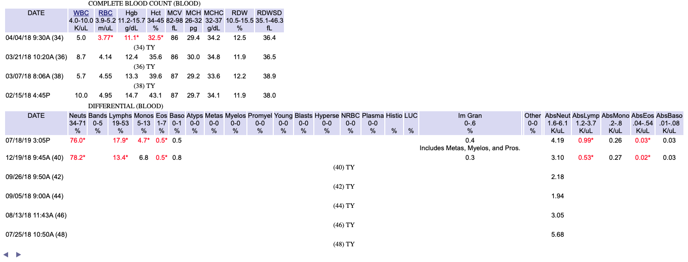
Inside my patient portal…

Slide 13
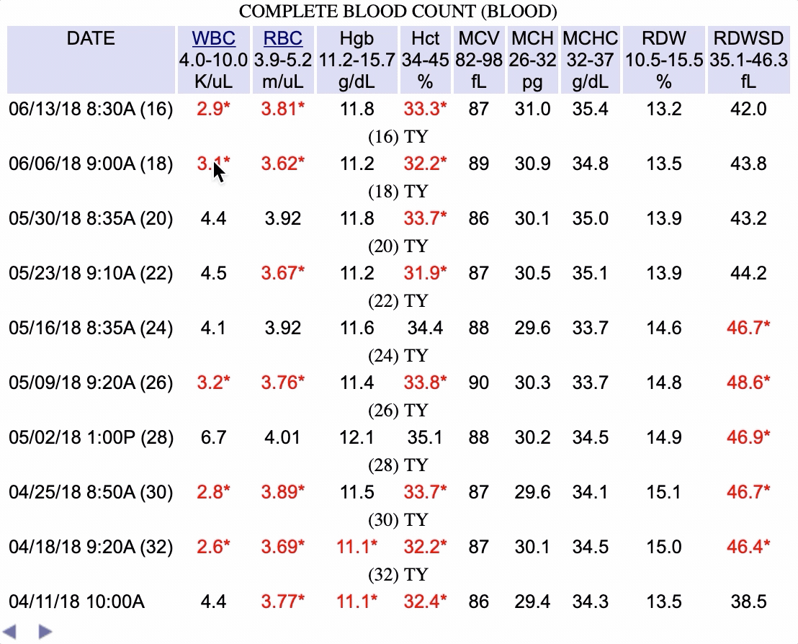
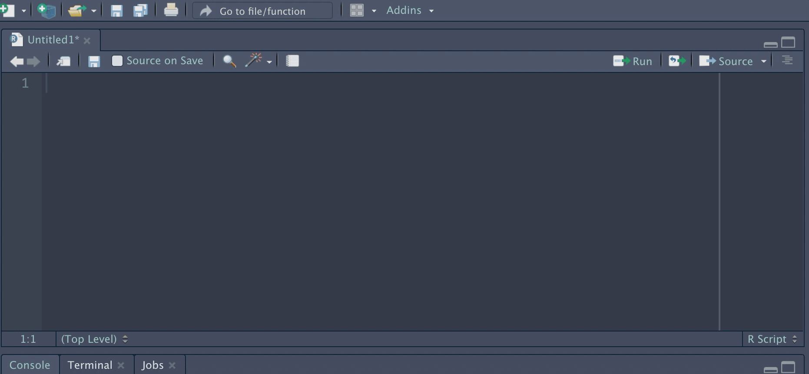
To RStudio…
It was a tedious process but I didn’t have much else to do!
with a lot of readr::parse_number()

Slide 14
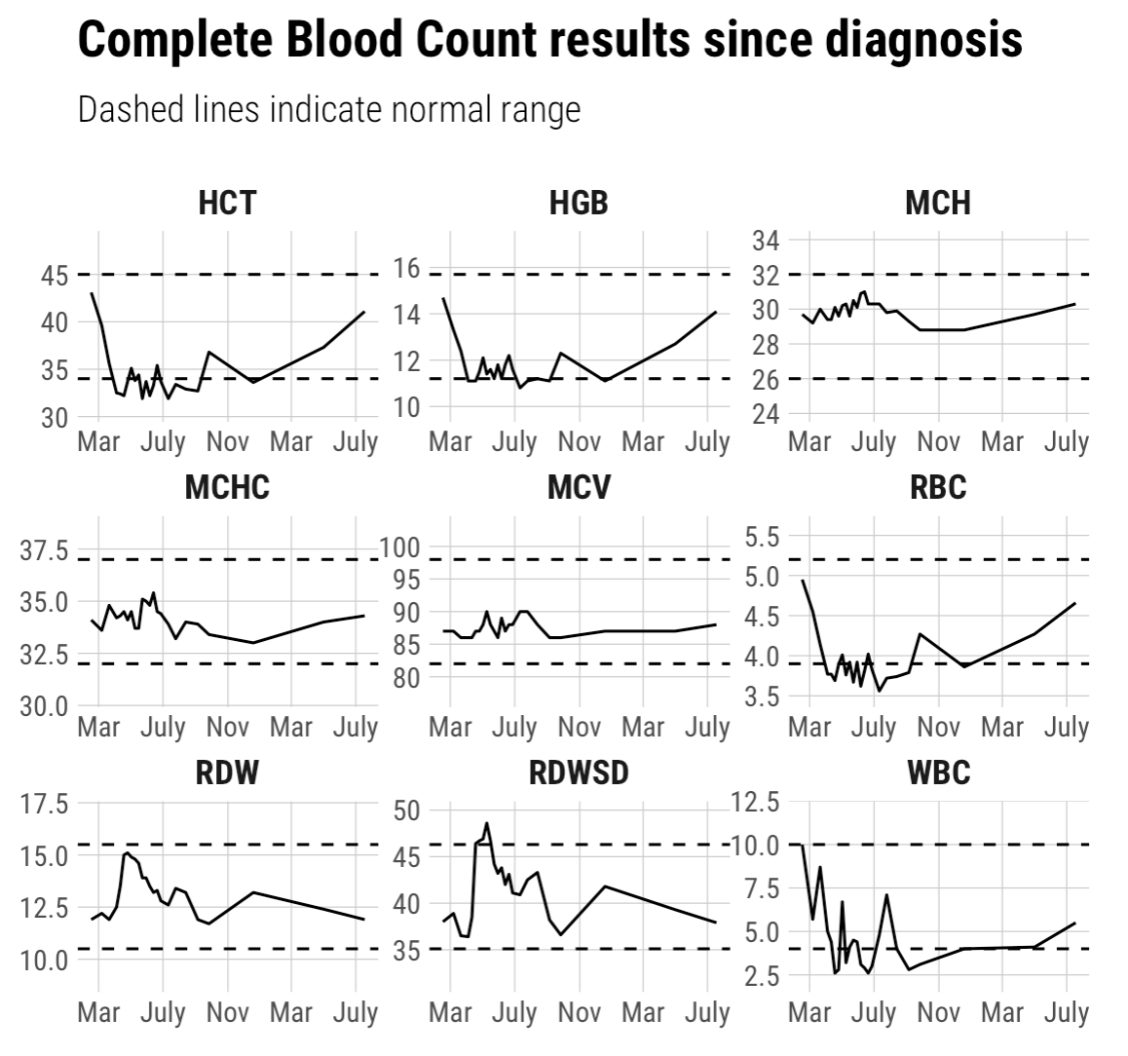
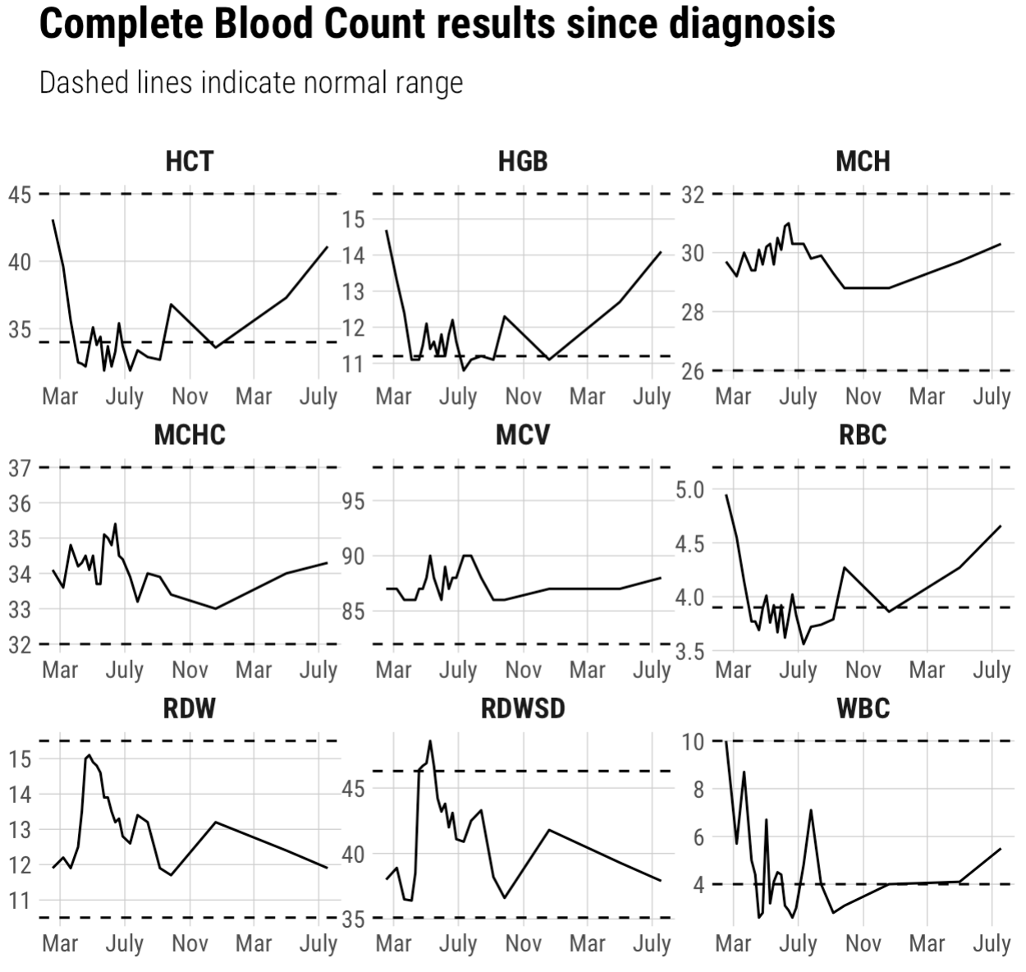
Almost…
perfect
The difference? 80 lines of ggproto stuff I don’t understand, from https://fishandwhistle.net/post/2018/modifying-facet-scales-in-ggplot2/

Slide 15
Neulasta chemo
Non-Neulasta chemo

Slide 16
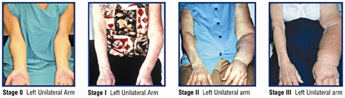
Lymphedema after axillary lymph node dissection
Image from https://columbiasurgery.org/news/2013/07/29/lympha-trial-seeks-prevent-lymphedema-breast-cancer-patients

Slide 17
Lymphedema monitoring

Slide 18
Even better!
Image from http://www.lymphedemablog.com
tribble(
~date, ~meas.right, ~meas.left,
"2018-07-31", "15.4/15.7/18/20.5/23.3/25/25/24/25/26.5/27.7/29.2", "15.8/16/17.5/19.8/22.5/24/24.8/24/25/26.5/28/29.1",
"2018-09-24", "16/16/18/20.5/23.5/25/25.6/25/26.2/27/29/29", "15.3/16.5/17.8/20.7/23/24.5/25.5/25.5/26.5/28/29.2/31",
"2019-01-10", "15.3/17/18.5/21.9/24/25.2/25.2/24.4/25.5/27/28.5/30", "15.5/16.1/18.5/20.8/23/24/24.5/24.5/26/27/28.5/30",
"2019-04-10", "15.6/17/19.1/21/24/24.5/24.3/25/27.5/29.1/31.5/33.3", "15.2/17.4/19.7/22.7/24.7/25.5/24.8/25.1/27/28.5/30.7/32.5",
"2019-08-14", "15.7/16.9/19/21/23/24/24/24.8/27/29.2/31.5/33.5", "15.5/17/19.4/22/24.7/25/24.5/25.5/27/29/30.5/33"
)
... separate_rows() ... pivot_longer() ...
Formula for arm volume!
mutate(
lag_meas = lag(meas),
val = 4 * (meas^2 + meas * lag_meas + lag_meas^2)
) %>%
summarise(new_vol = sum(val, na.rm = TRUE) / (12 * pi))

Slide 19
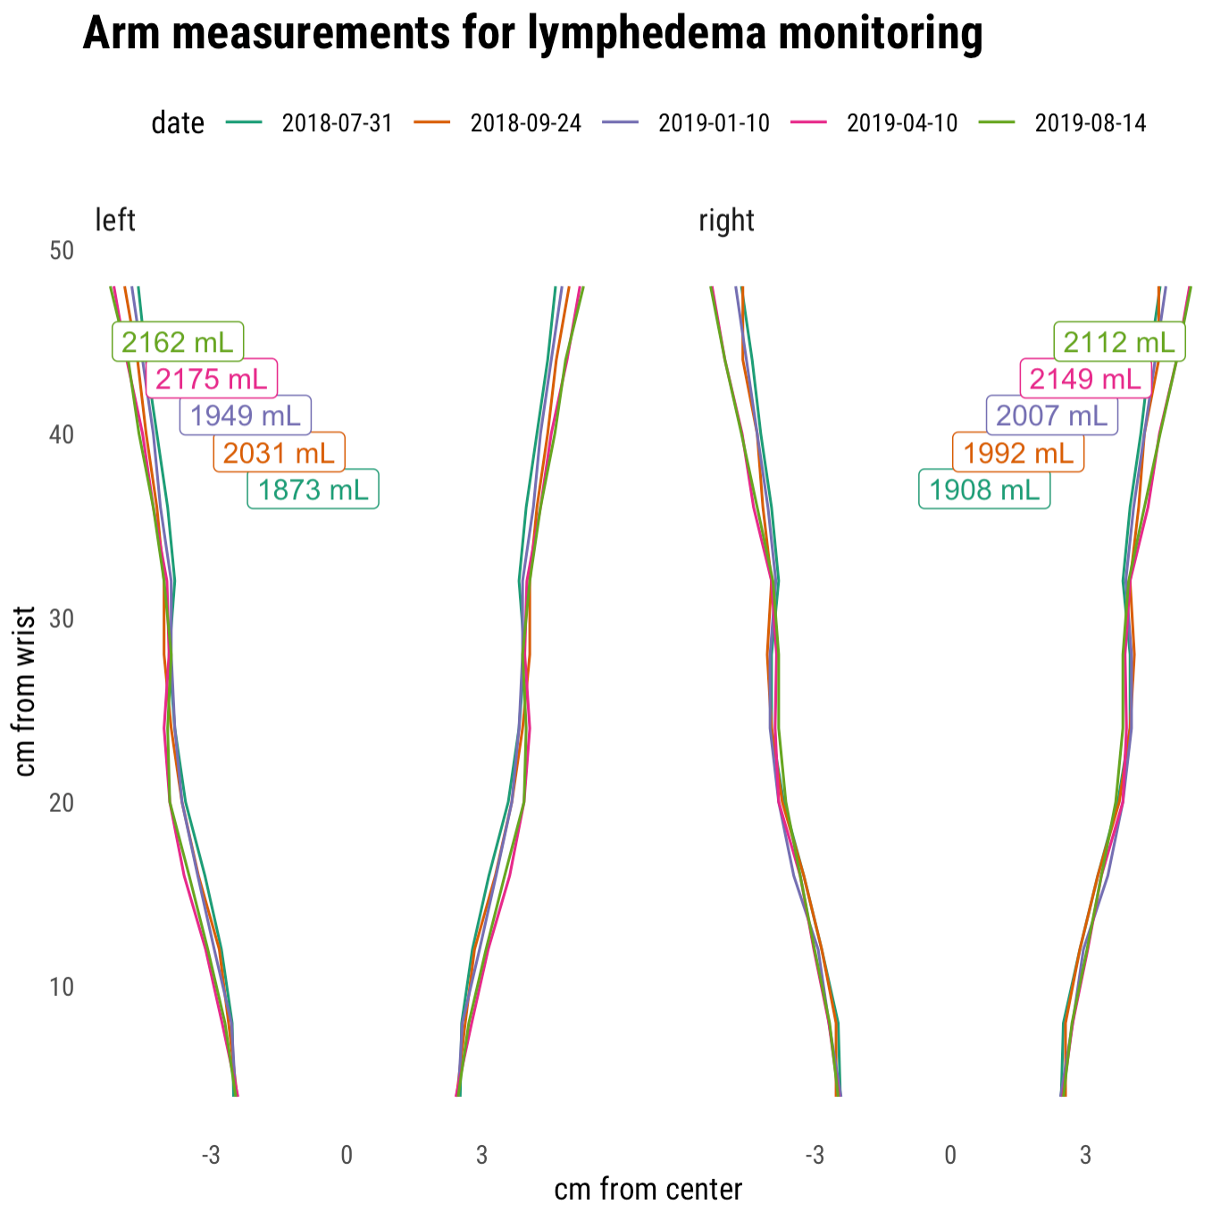
No sign of lymphedema! 🤞🤞🤞

Slide 20


Slide 21
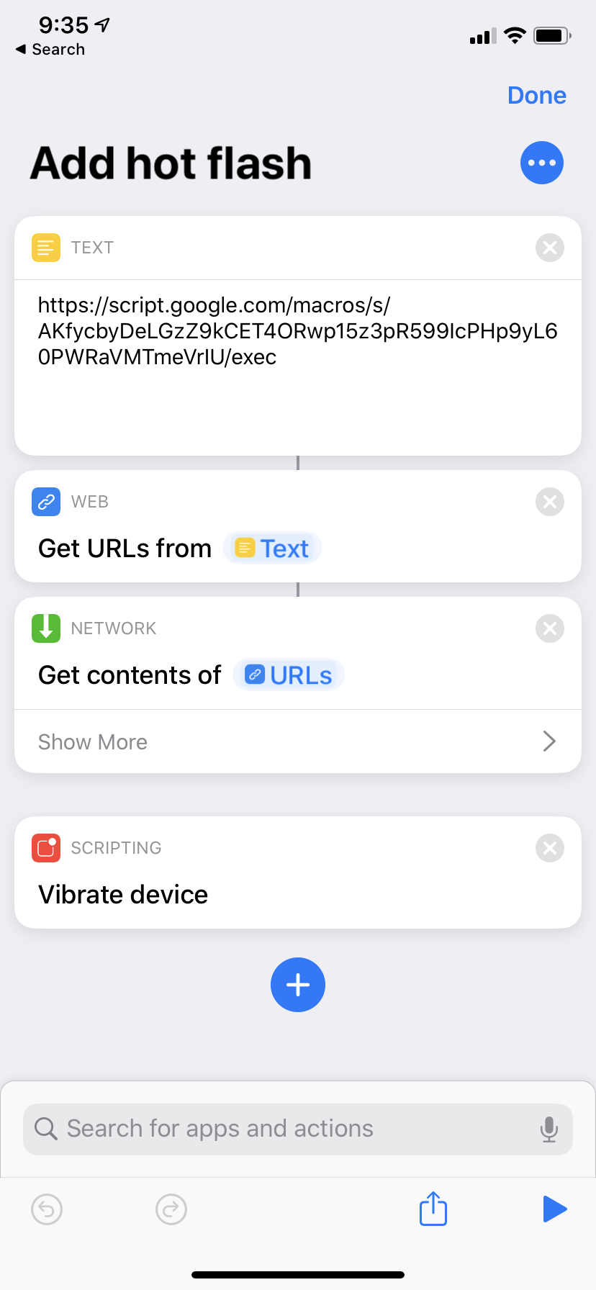
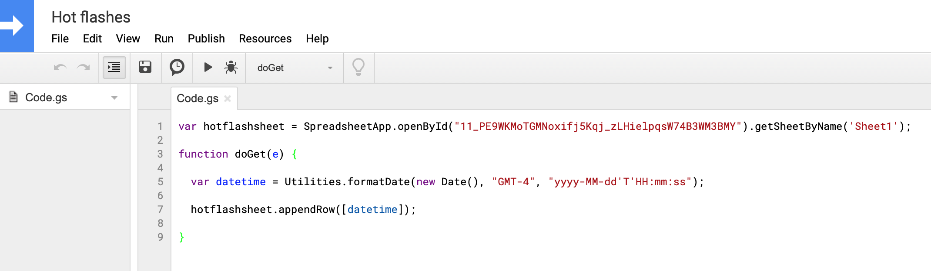
I have no idea what I’m doing….
Https://developers.google.com/apps-script
https://script.google.com/home
Android option? Action Blocks? https://www.blog.google/outreach-initiatives/accessibility/action-blocks/

Slide 22
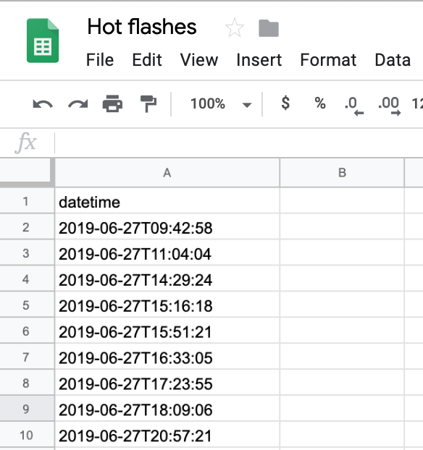
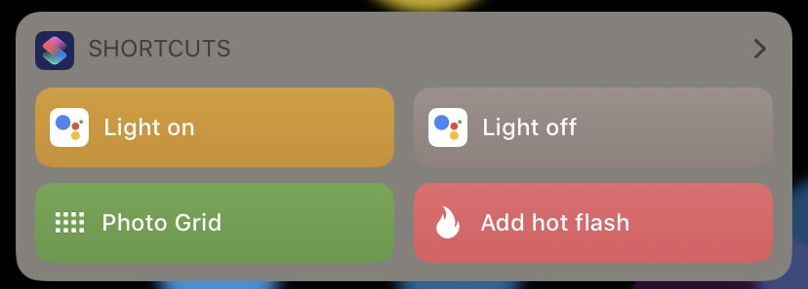
But it worked!

Slide 23
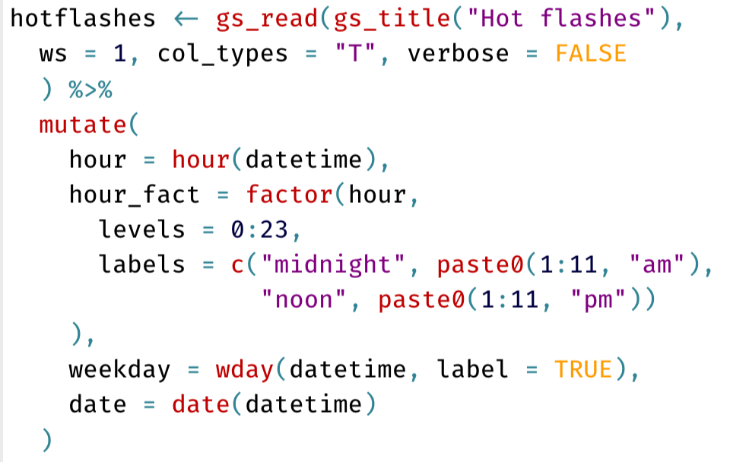
Now the R part…
Collect data
Read in data right from Google Sheets
New Google API – use googlesheets4 instead!
Visualize data
I used the gt package for html tables
The sugrrants package for time series visualization

Slide 24
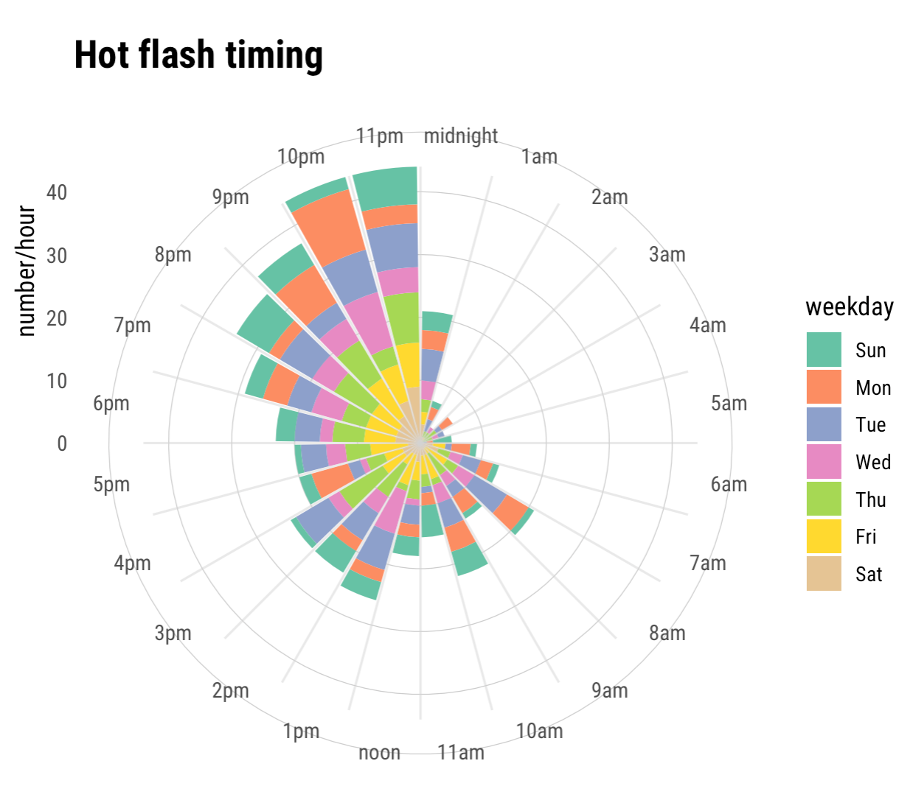
Worst time is bedtime
When they wake me up I’m usually too sleepy to record
Other missing data!

Slide 25
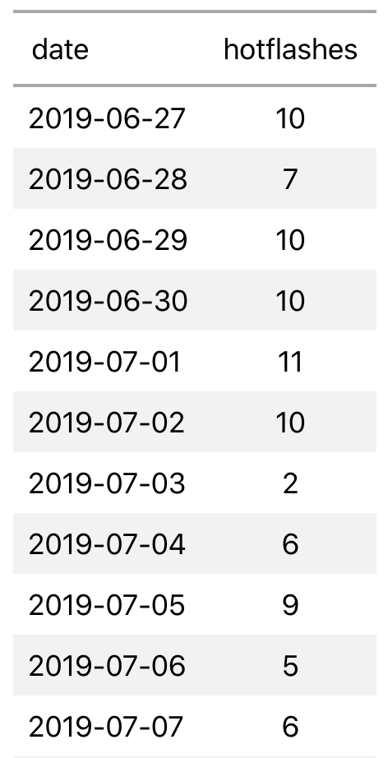
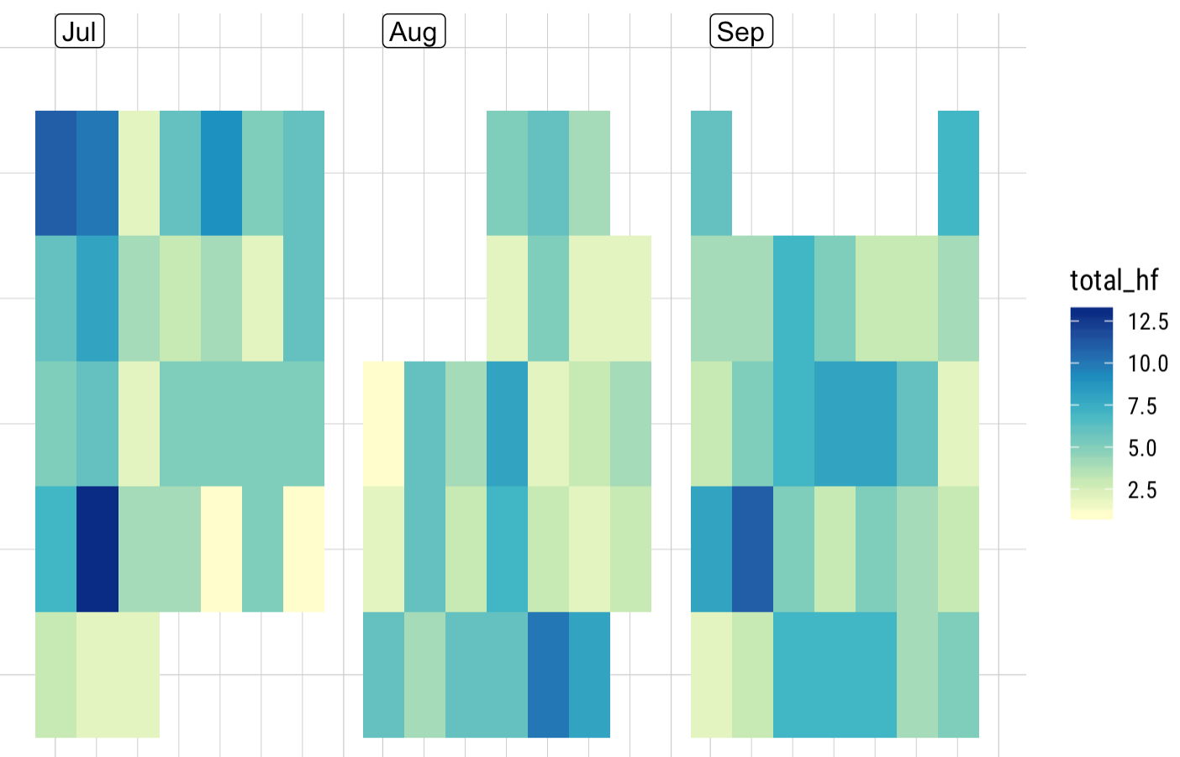
I had this on a (very basic) Shiny app so I could see my data on the go!

Slide 26
💰 💰 💰
How much was this all costing?
Me? Luckily, relatively little
https://www.npr.org/sections/health-shots/2019/02/26/696321475/cancer-complications-confusing-bills-maddening-errors-and-endless-phone-calls
My insurance company? Tonnnnnnnns
But how to get that data?

Slide 28
Process (/struggle)
Collect data
Many attempts via rvest to get past the password protection
Landed on RSelenium – allows for interactive session, easier troubleshooting (but not a lot of help out there!)
(brief demo)
Visualize data
I really wanted to make a gganimate gif of medical bills over time
My first ever issue filed on github! https://github.com/thomasp85/gganimate/issues/172
Full explanation here:
https://www.louisahsmith.com/post/secrets-and-robots/

Slide 29
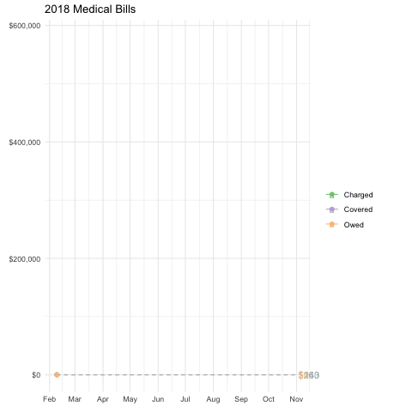

Slide 30
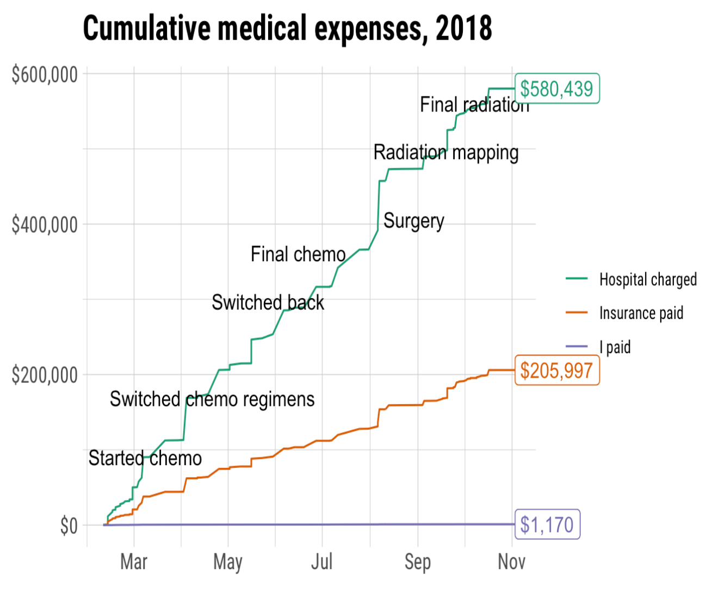
Conclusion:
(this is only medical bills, not pharmacy, but)
I was really,
really lucky!

Slide 31

Putting it all together
October: breast cancer awareness month
Recommended reading:
https://web.archive.org/web/20110609202708/http://www.barbaraehrenreich.com/cancerland.htm
http://thinkbeforeyoupink.org/resources/history-of-the-pink-ribbon/
https://www.nytimes.com/2015/10/31/health/breast-cancer-awareness-pink.html

Slide 32
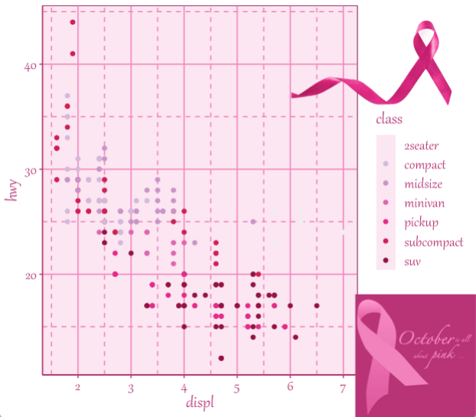
If everything is going to be pink this month, why not ggplot?!

Slide 33
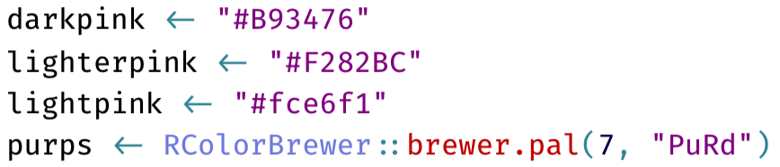
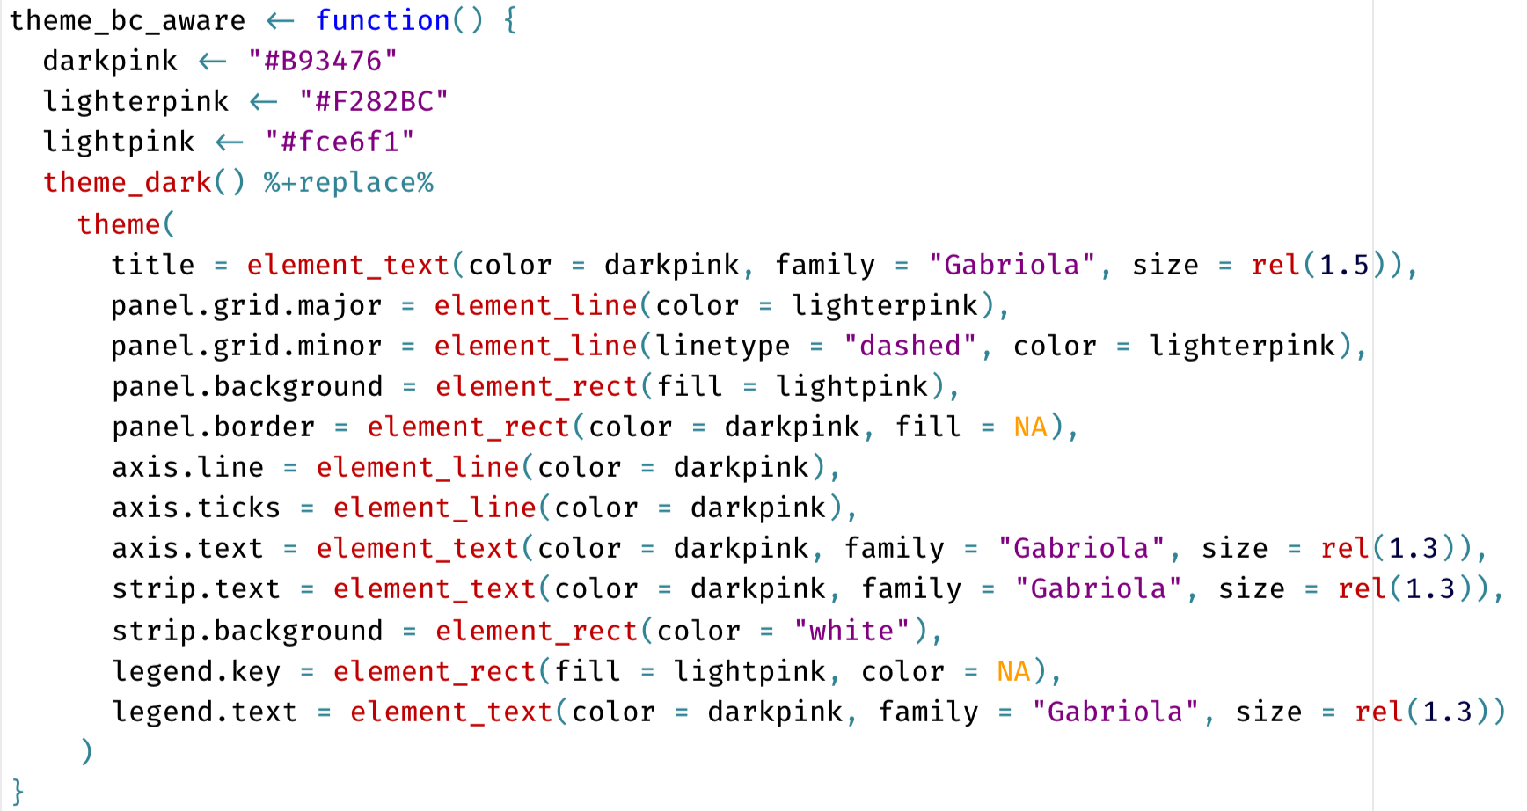
How to make a ggplot2 theme
Better resource than me: https://bookdown.org/rdpeng/RProgDA/building-a-new-theme.html

Slide 34

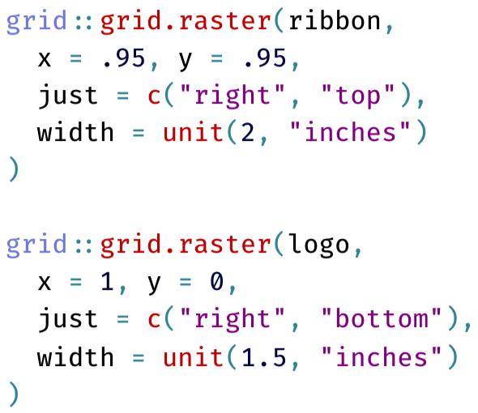

Add some logos
http://clipart-library.com/breast-cancer-ribbon.html

Slide 35
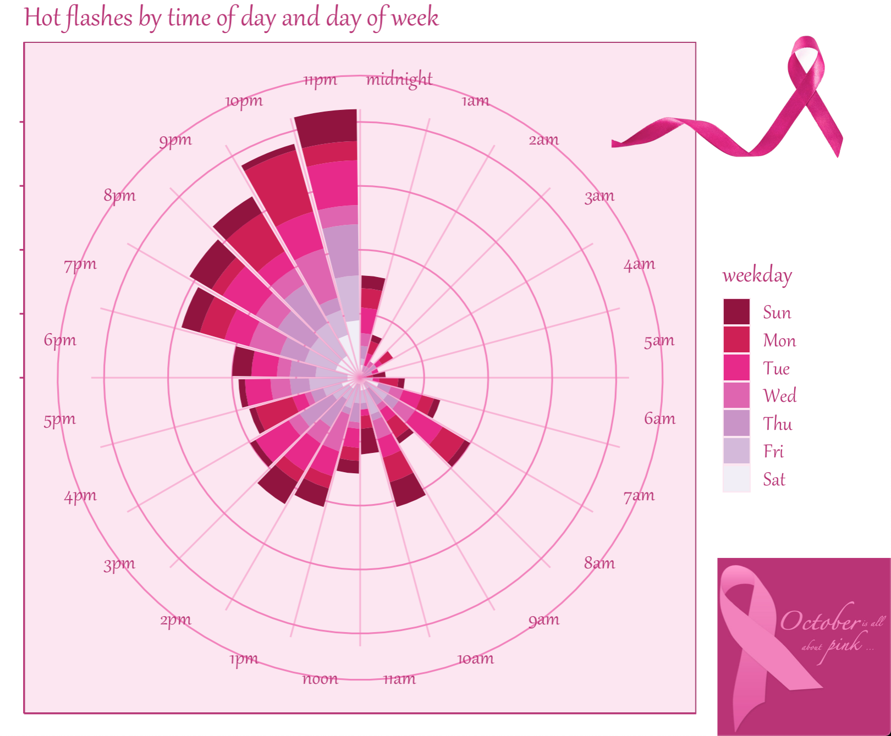

https://twitter.com/louisahsmith/status/1179429494664388609

Slide 36
So…
My first R project was a shiny app for analyzing my running data
(way over my head but I learned A TON)
I like to collect data on myself – I know that’s not true for everyone
I had a lot of time on my hands when I wasn’t sick enough to lie there doing nothing but not well enough to think hard!

Slide 37
R packages I’ve mentioned using
tidyverse: https://www.tidyverse.org
lubridate: https://lubridate.tidyverse.org
datapasta: https://milesmcbain.github.io/datapasta/
RcppRoll
ggrepel: https://ggrepel.slowkow.com
googlesheets4: https://googlesheets4.tidyverse.org
gt: https://gt.rstudio.com
sugrrants: https://pkg.earo.me/sugrrants/
shiny: https://shiny.rstudio.com
Rselenium: https://ropensci.org/tutorials/rselenium_tutorial/
gganimate: https://gganimate.com

Slide 38
Where to find me
www.louisahsmith.com
@louisahsmith
louisa_h_smith@g.harvard.edu
Shiny app for some of my research: http://selection-bias.louisahsmith.com
I do do real work sometimes!

